Slide 1
Bank-Marketing-Campaign-Analysis using Machine Learning
By:
Rumana Shaikh
Manasi Potade
Shashank Mishra
Kushank Desai
Samir Solanki

Slide 2
Agenda
Understanding Problem Statement
EDA-Exploring trends in Data Set
Model Building
Hyperparameter Tuning and Model Evaluation
Results & Outcome
Recommendation to marketing team

Slide 3
Problem Statement
Abstract-Data from a marketing campaign run by Banco de Portugal is examined. The campaign’s aim was to increase customers’ subscription rates to fixed-term deposit products, such as CDs. Using knowledge from the course, a number of machine learning algorithms are implemented to answer the question: How can banks successfully market these products in the most efficient way possible and with the highest possible rate of success?
Goal-The classification goal is to predict if the client will subscribe (yes/no) a term deposit(variable y).
To improvise the marketing campaign of bank by analyzing the past sampling data and recommending right target customer.

Slide 4
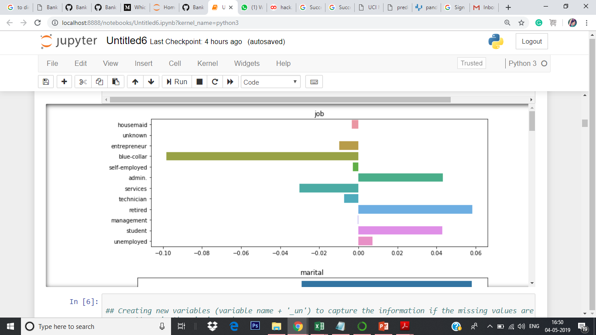
EDA
Dataset with 20 features for 41,000 clients with binary target variable.
Understanding the trends & correlation among each features.

Slide 5
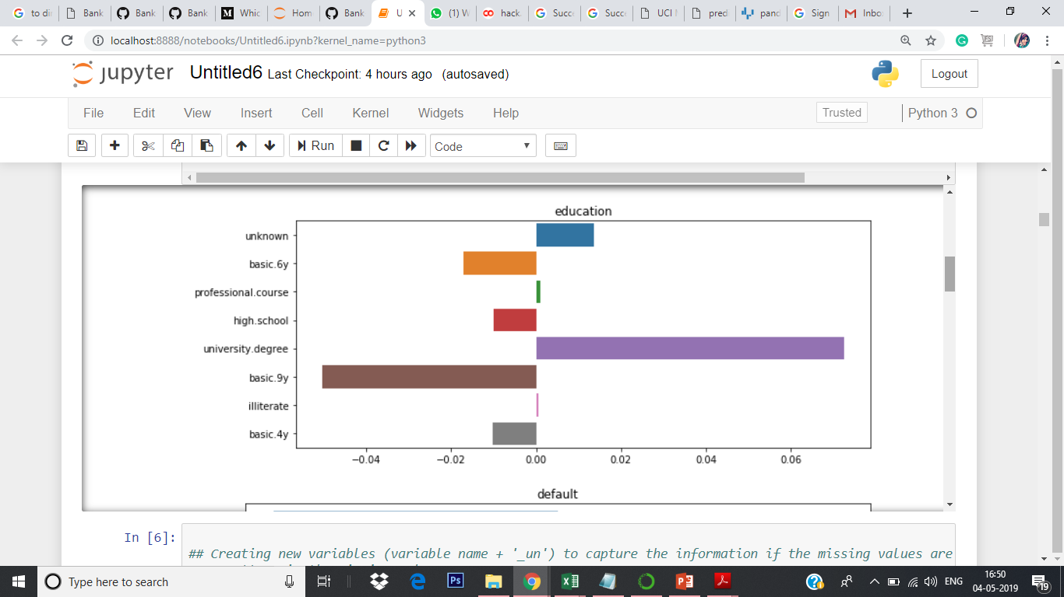
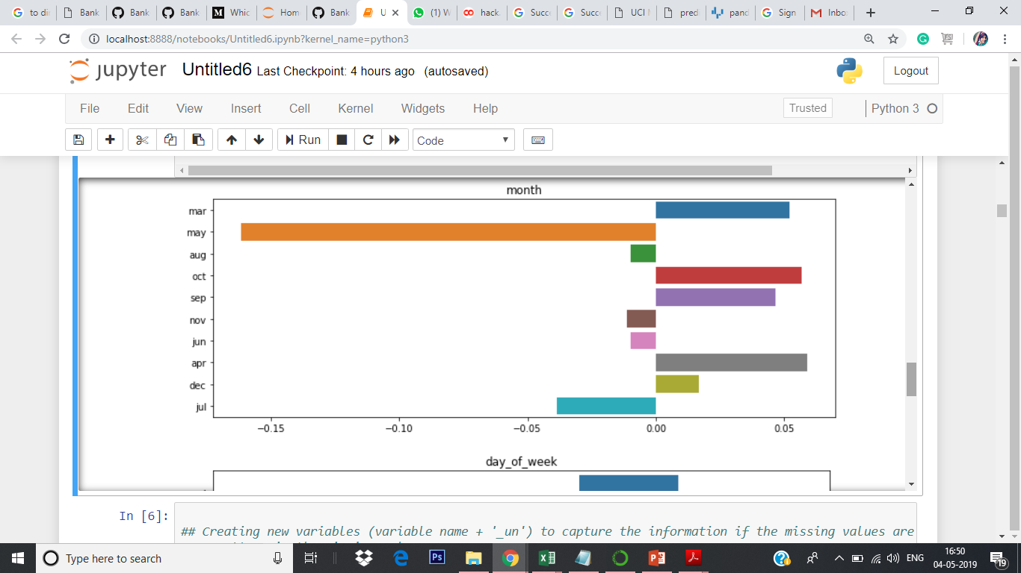
Features Comparison

Slide 6
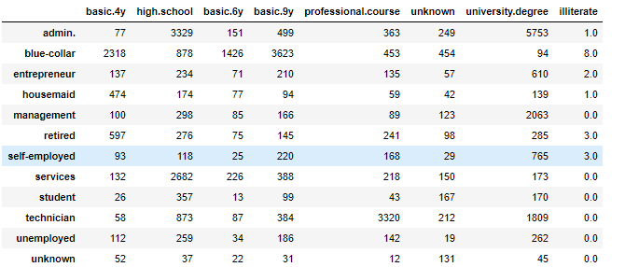
Handling the missing values

Slide 7
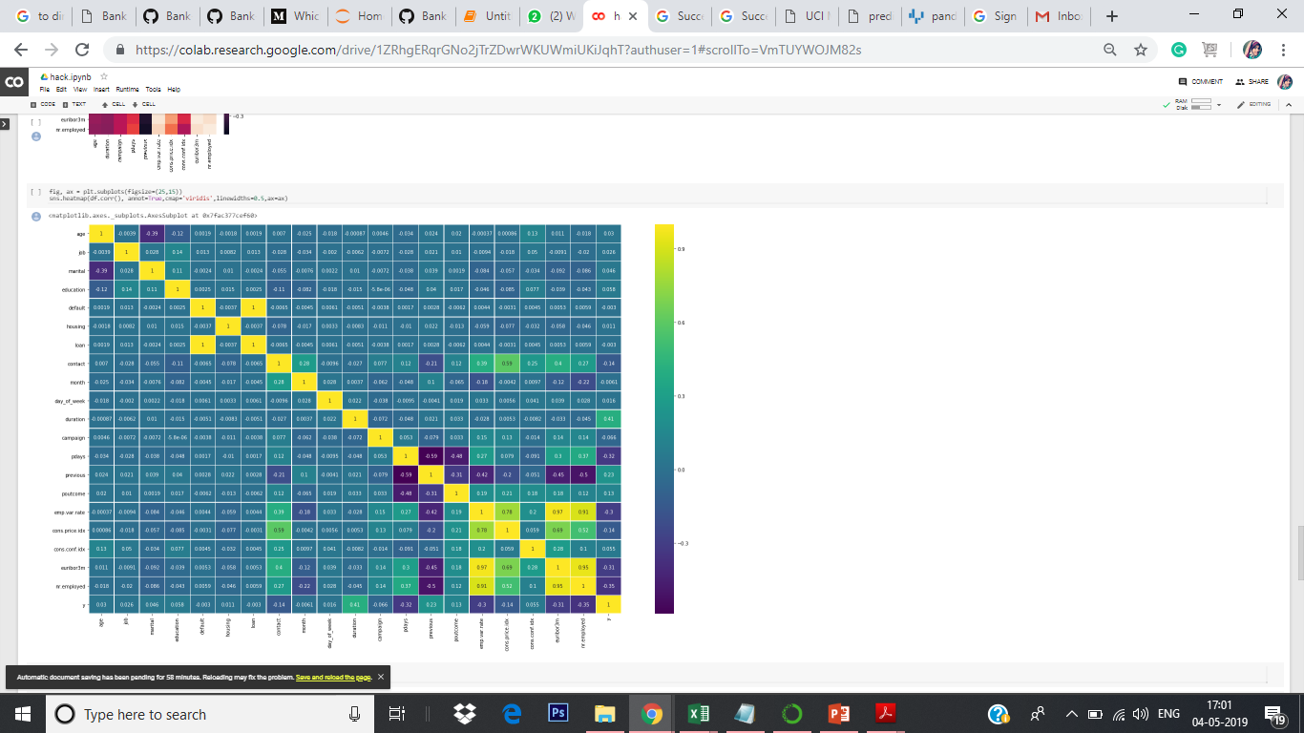
Correlation Heatmap

Slide 8
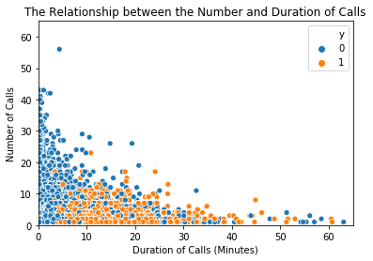
Scatter Plot –Relationship between number of calls and its durations w.r.t target variable

Slide 9
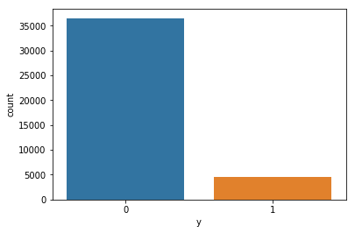
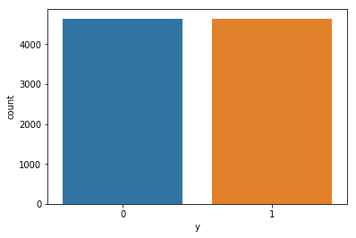
Data Imbalance Count Plot
BEFORE
AFTER

Slide 10
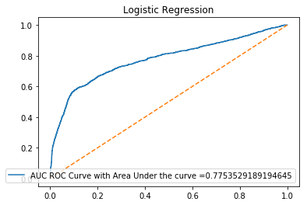
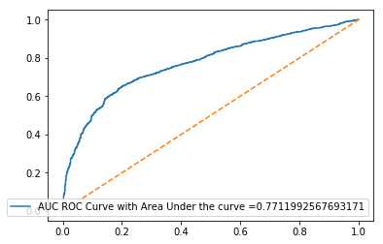
Logistic Regression
AUC ROC Curve-Imbalanced Data set
AUC ROC Curve-Balanced Data set

Slide 11
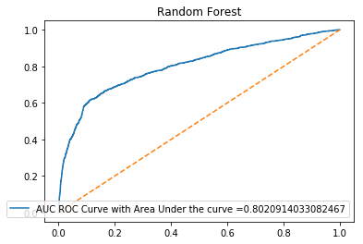
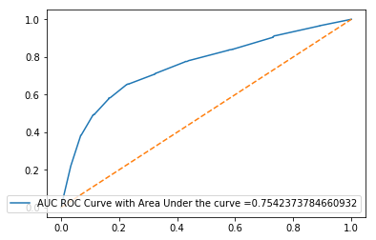
Random Forests
AUC ROC Curve-Imbalanced Data set
AUC ROC Curve-Balanced Data set

Slide 12
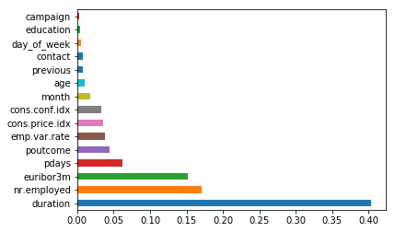
Feature Importance

Slide 13
Dropping column Duration
We have dropped the 'duration' variable as the value of the variable will only be known at the end of the call.
Hence, at that time we will also know the outcome of the call.
The 'duration' variable will lead to leakage in the data and the prediction model will not be realistic.

Slide 14
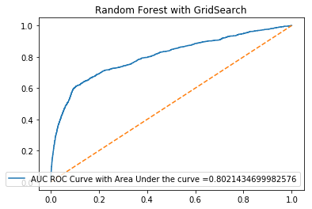

Random Forests + Grid Search
AUC ROC Curve-Imbalanced Data set
AUC ROC Curve-Balanced Data set

Slide 15
Comparison Chart for our models

Slide 16
Model Building Summary
Algorithm | Accuracy |  | Precision |  | Recall |  | F1 Score |  | AUC ROC Score
 | IMBALANCED | BALANCED | IMBALANCED | BALANCED | IMBALANCED | BALANCED | IMBALANCED | BALANCED | IMBALANCED | BALANCED
Logistic Regression | 90 | 72 | 69 | 77 | 20 | 63 | 32 | 69 | 77 | 77
Random Forest | 90 | 69 | 70 | 73 | 19 | 63 | 30 | 67 | 80 | 75
Random Forest + Grid search | 90 | 73 | 68 | 79 | 21 | 64 | 32 | 71 | 80 | 78

Slide 17
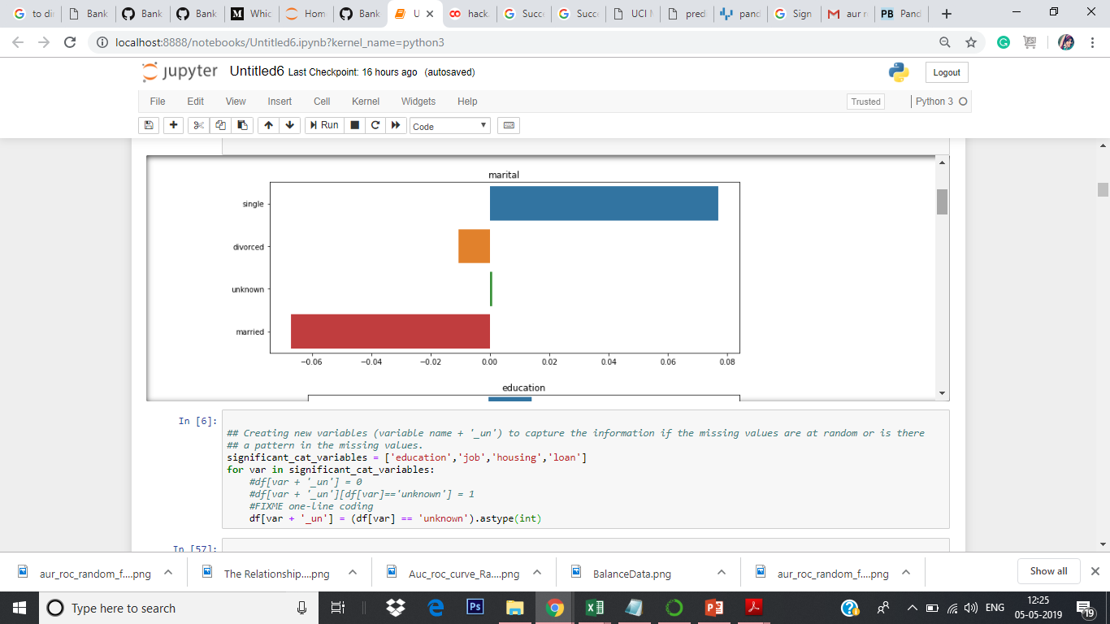
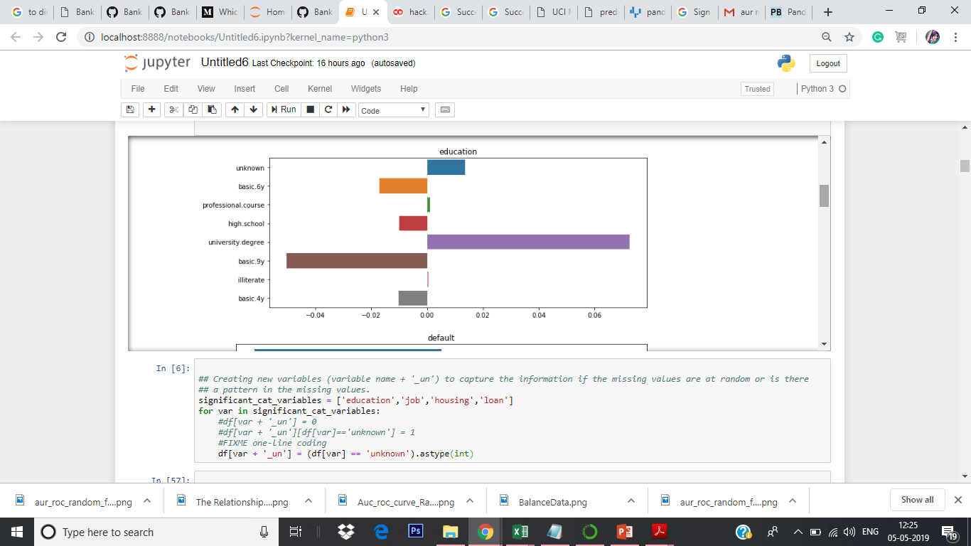
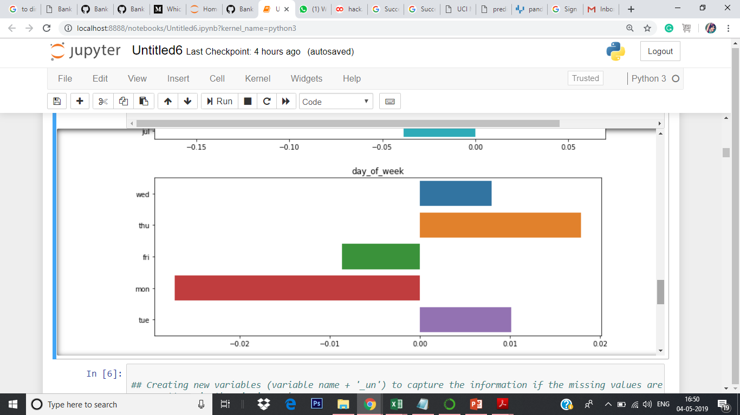
Recommendations

Slide 18
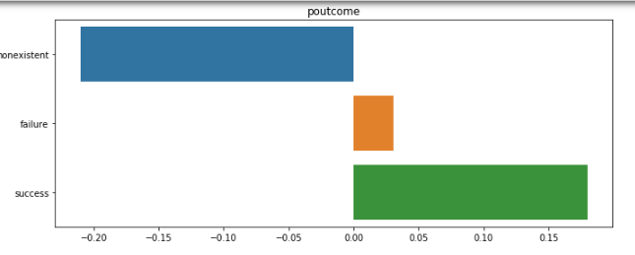
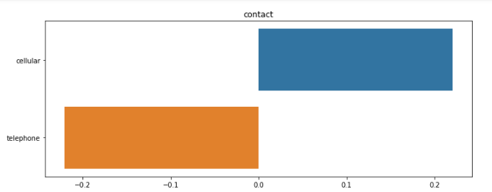
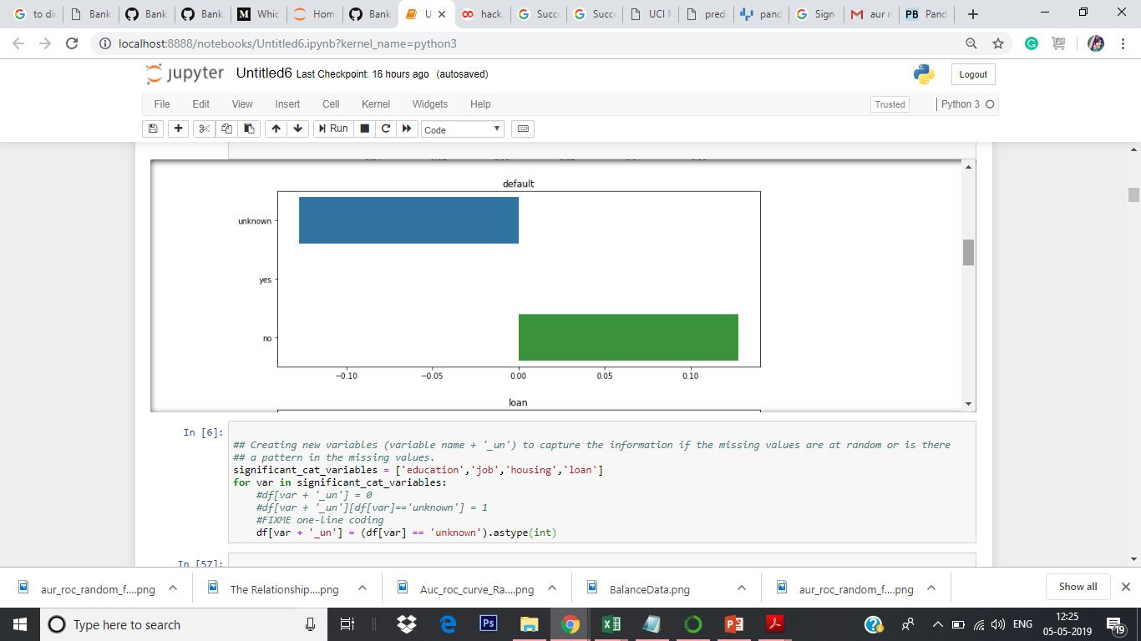
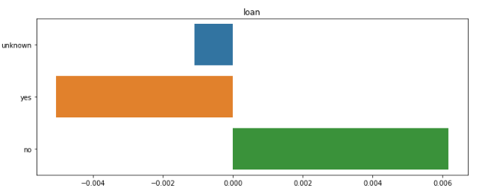

Slide 19
Conclusion
Target relatively Old Age people.
Prioritize those customers to who were the part of the previous campaigns.
According to the plot for both logistic regression and random forest, we can tell that the most influential variables are duration, nr.employed, euribor3m, and emp.var.rate.
Based on signs of coefficients of variables in logistic regression, “duration” has positive effect on people saying “yes”. This is because the longer the conversations on the phone, the higher interest the customer will show to the term deposit.
“nr.employed”, which is the number of employees in the bank, has positive effect for turning people to subscribe the term deposit. This can be due to the fact that the more employees the bank have, the more influential and prestigious this bank is.
“euribor3m” is another important variable, which denotes the euribor 3 month rate.
This indicator is based on the average interbank interest rates in Eurozone. It also has positive effect since the higher the interest rate the more willingly customer will spend their money on financial tools.
Employment variation rate (emp.var.rate) has negative influence, which means the change of the employment rate will make customers less likely to subscribe a term deposit.
This makes sense because the employment rate is an indicator of the macroeconomy. A stable employment rate denotes a stable economic environment in which people are more confident to make their investment.

Slide 20
We could also analyse the impact of positive account balance maintained by the clients and where the previous column = 0 can be potential client database to pitch for Term deposit.
Future Scope

Slide 21
Thankyou

